Slide 1

DEV OPS PROJECT
By Ashleigh Francis
& Sebastian Hook

Slide 2

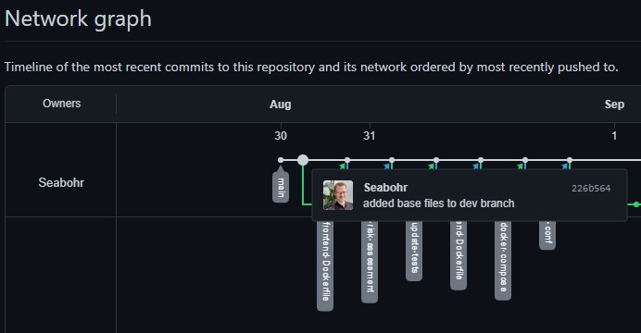
Planning - GitHub

Slide 3
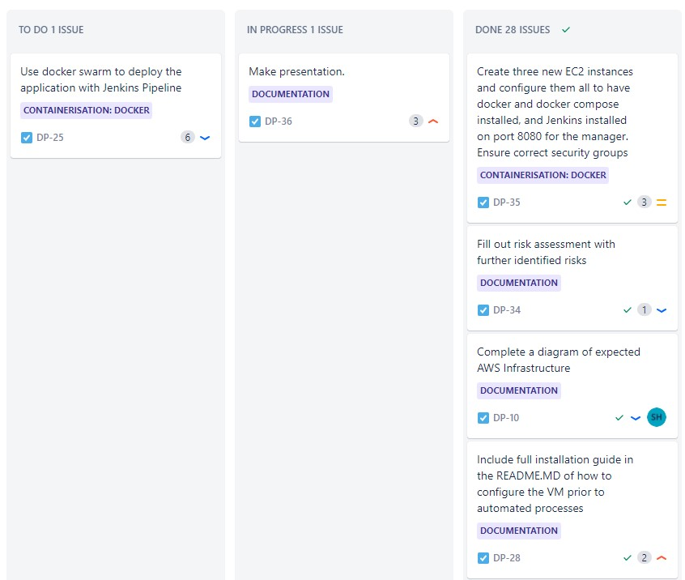
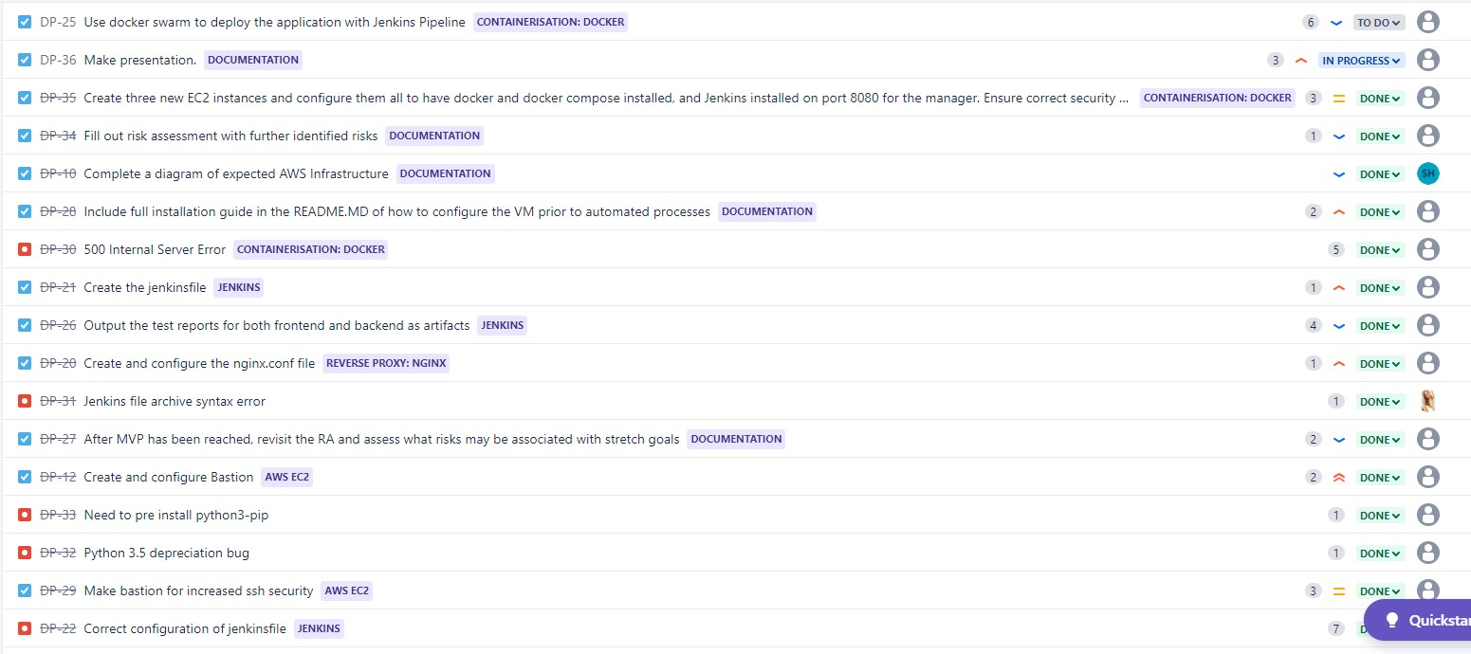
Planning - Jira

Slide 4
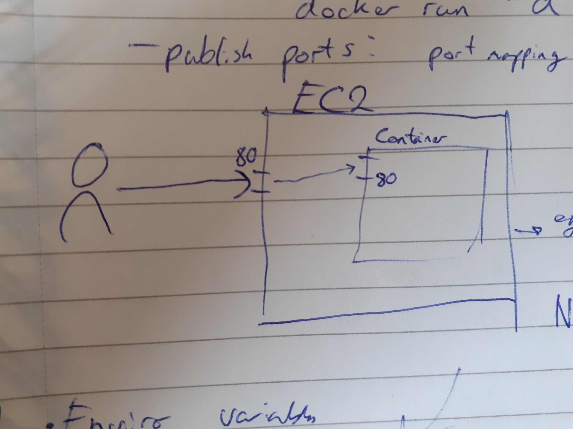
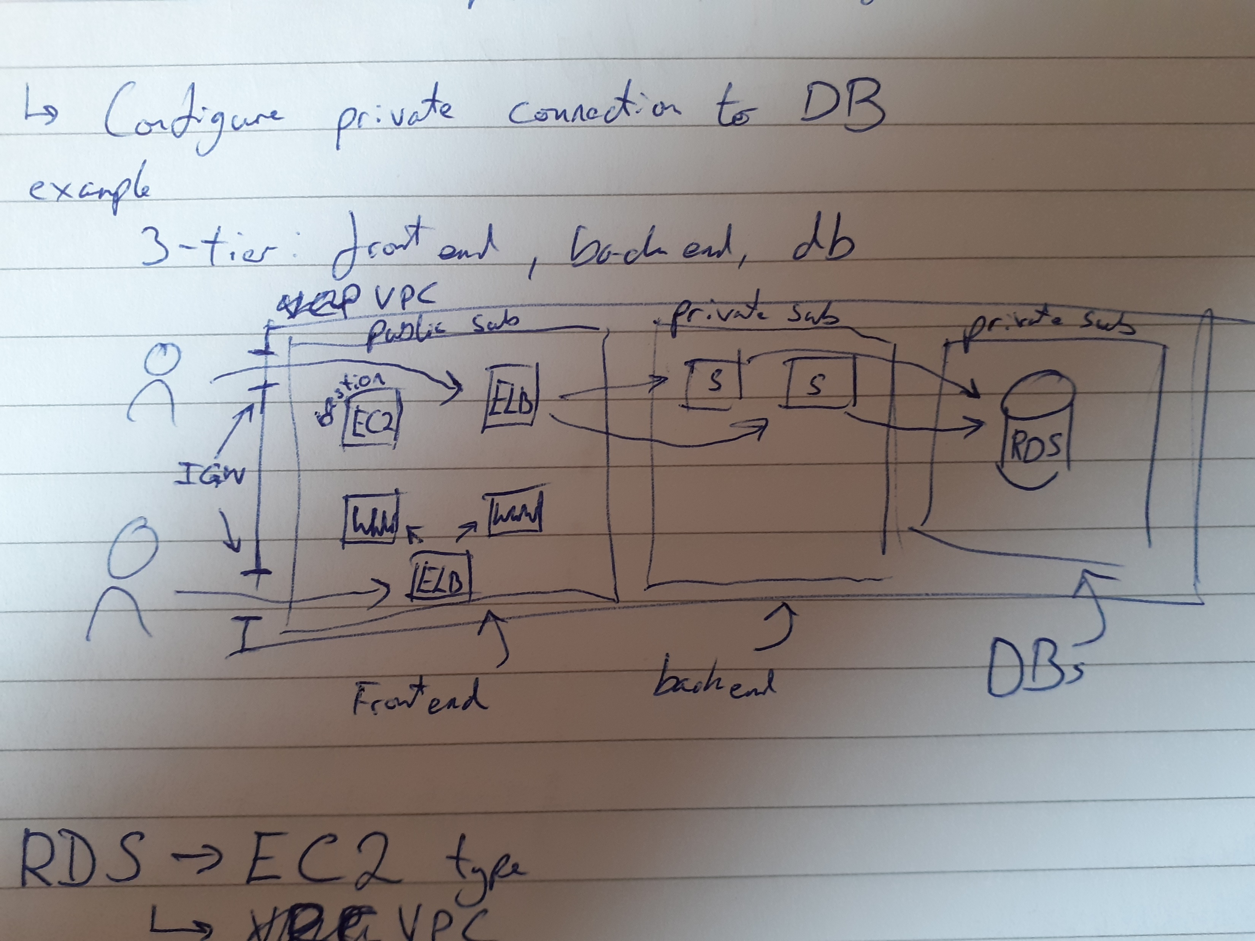
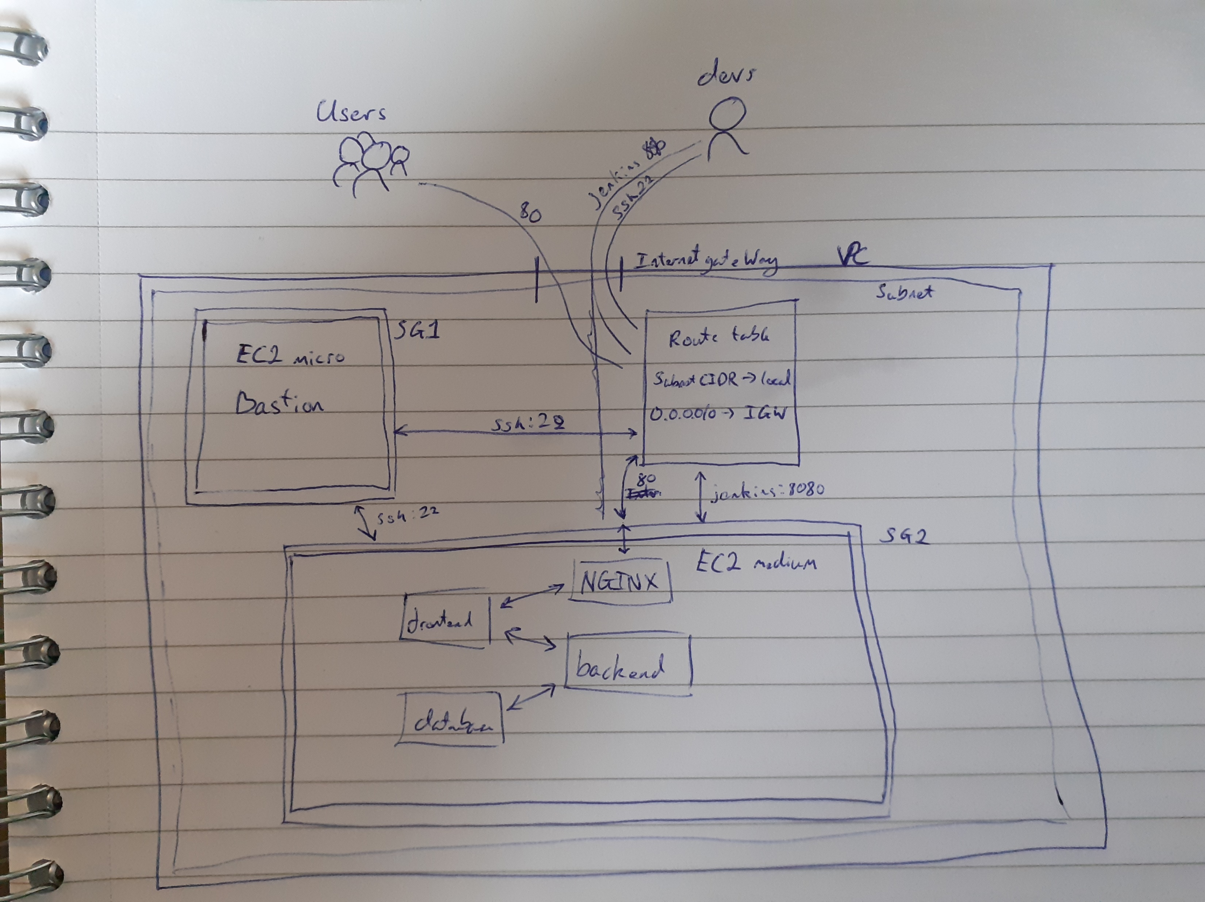
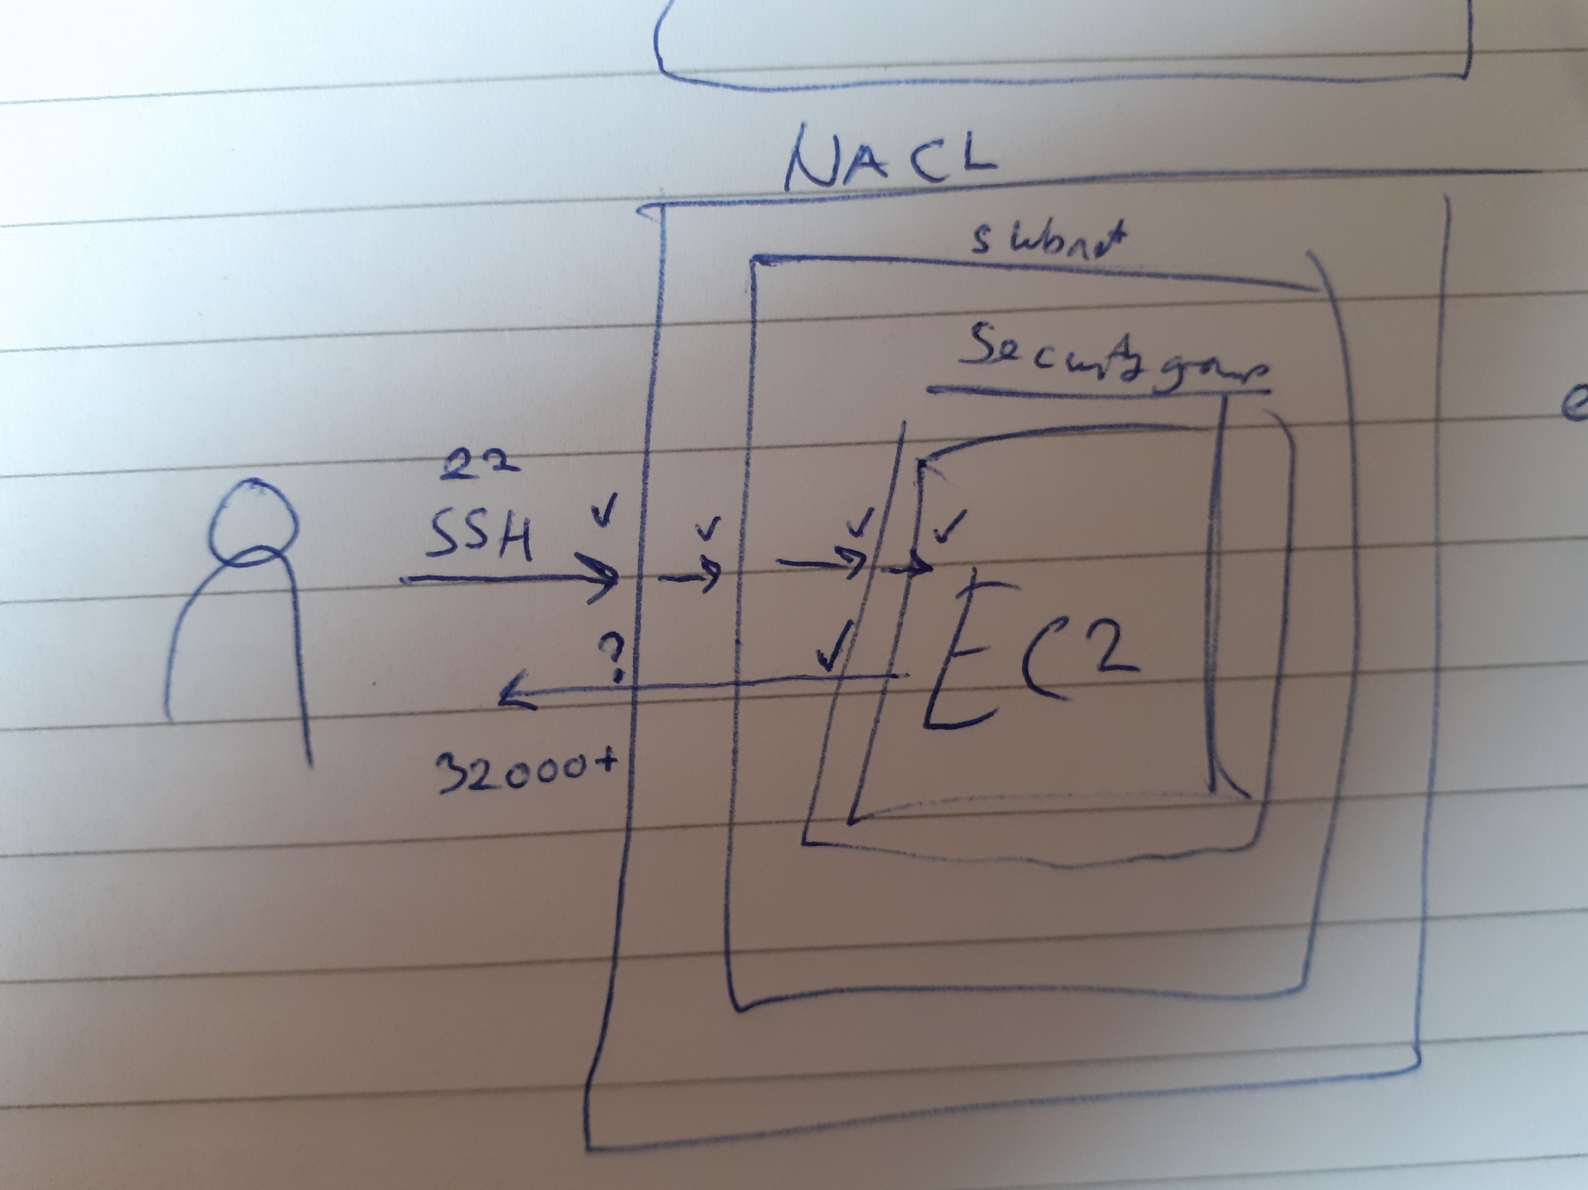
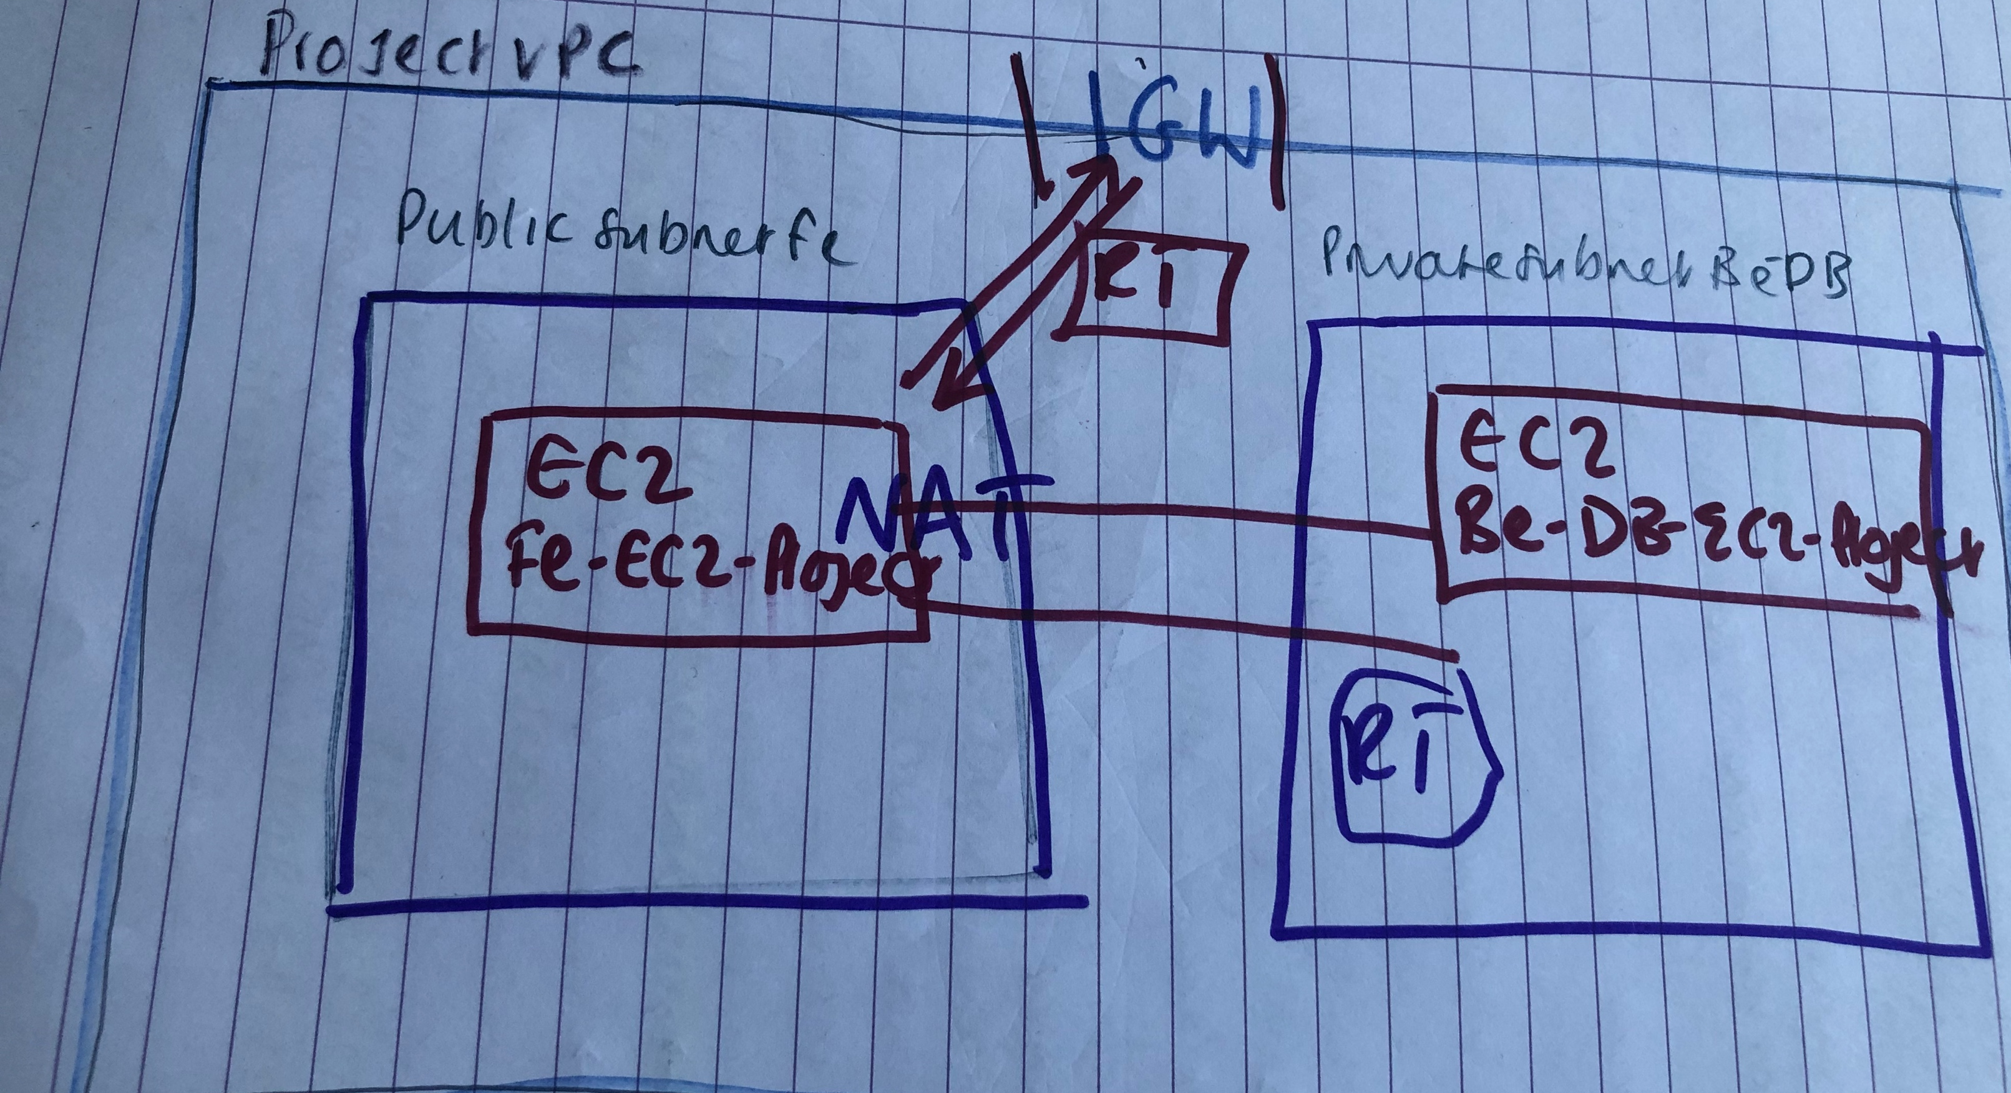
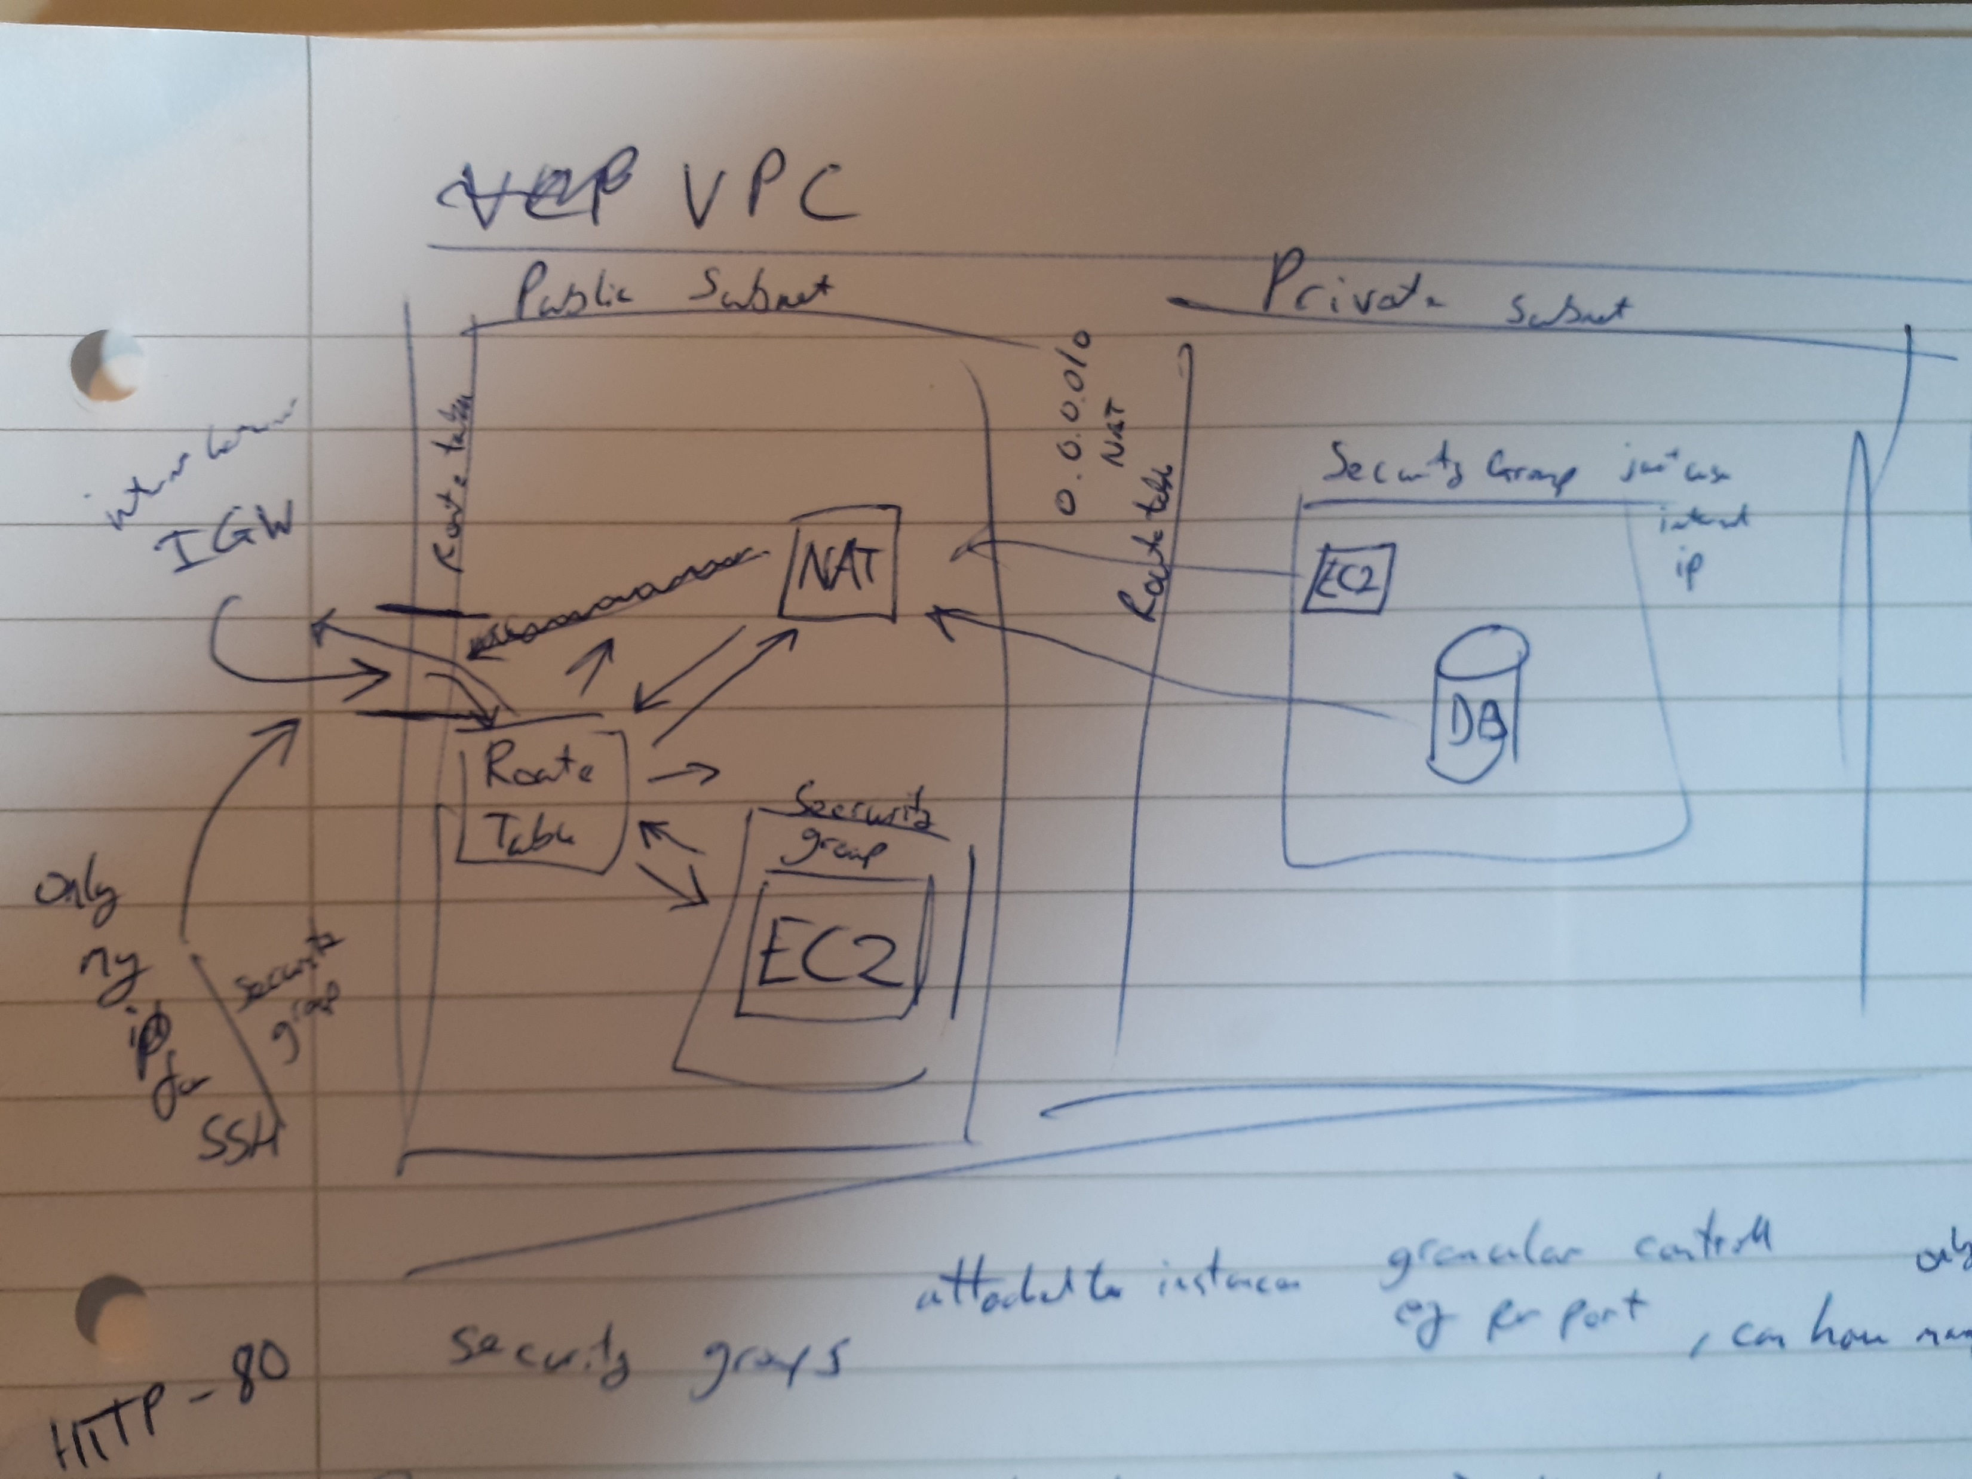
Planning – MVP + Peer Programming
Main goal
MVP
Early structure
Peer Programming
Ensure reliability
Reduce risk of error

Slide 5
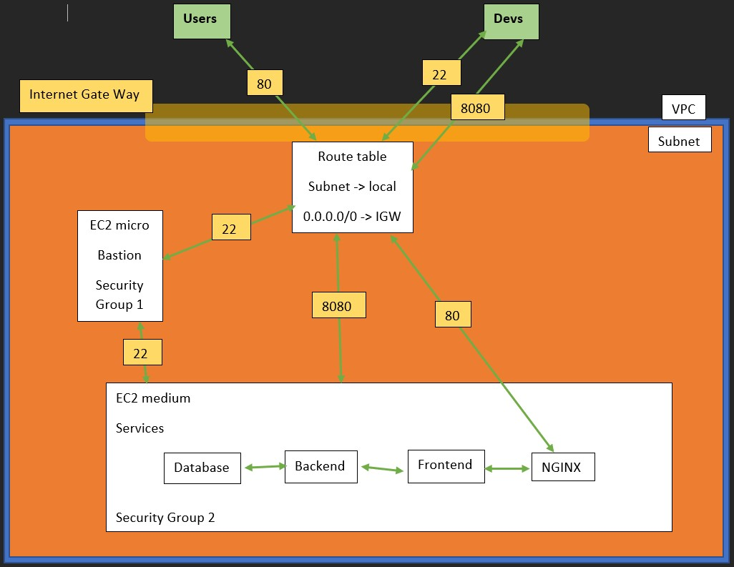
Build:
AWS infrastructure

Slide 6
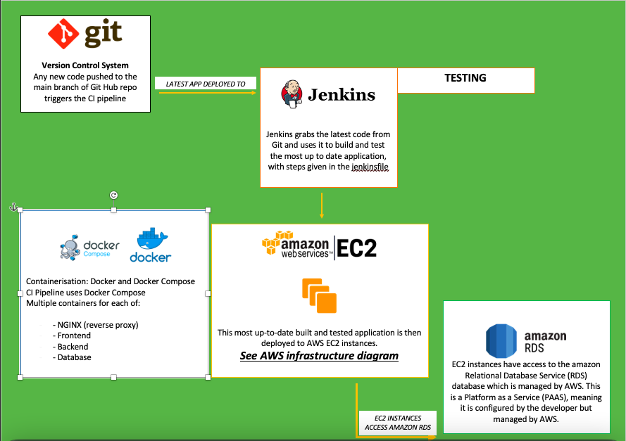
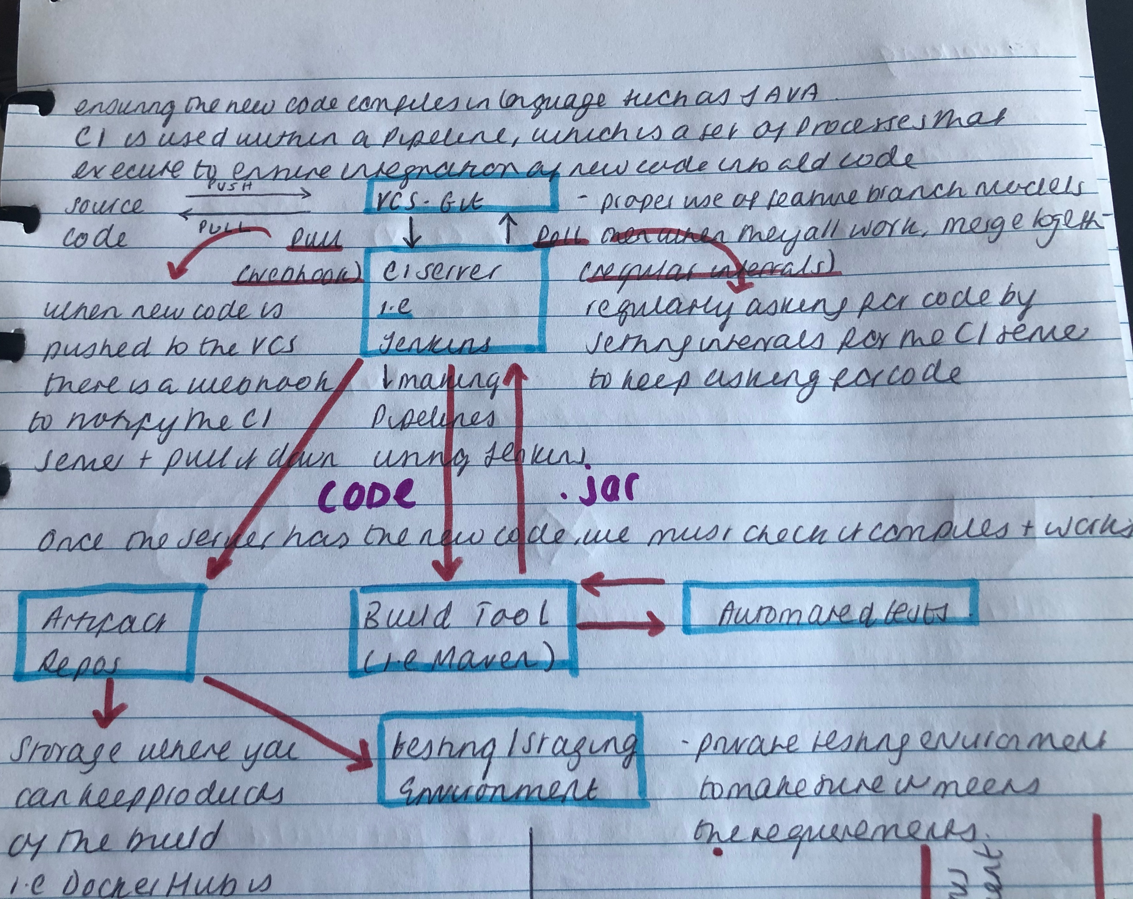
CI Pipeline

Slide 7
Test Reports??

Slide 8
Reflection and Summary
Positives
Teamwork
Use of methods decided at the start, peer programming and Git.
Application is successfully deployed and functional
Ways to improve:
Use of Docker Swarm.

